Slide 1

Vision-based Judgment of Tomato Maturity
Using Extreme Learning Machines
Roberto D. Saldaña Jr.
2009-09630
February 26, 2014

Slide 2
Outline
Introduction
Literature Review
Statement of the Problem
Objectives
Proposed Approach
Experiments and Results
Conclusion and Future Works

Slide 3
Introduction

Slide 4
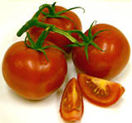
Tomato
Lycopersicon esculentum
Spanish word, tomate
Economically important fruit
Tomato makes you happy ☺

Slide 5
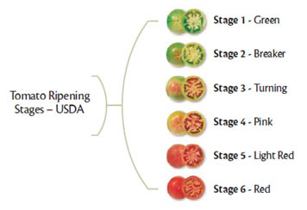
Tomato Maturity Stages

Slide 6
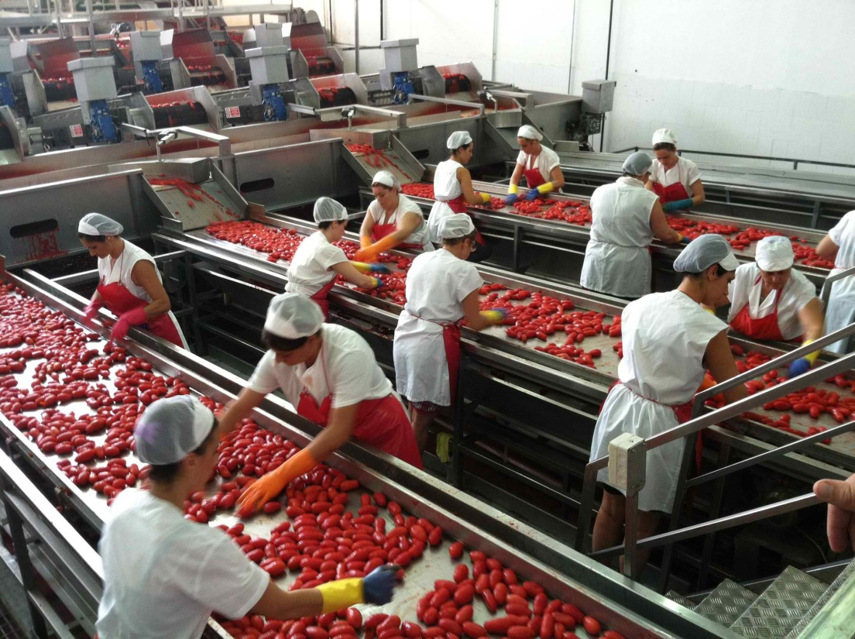
Current Process
Manual Classification
Human Graders

Slide 7
Why Automate?
time consuming, tedious, expensive
brightness, vividness
save time and expense
improved quality, abolish inconsistency, reduce dependence

Slide 8
How to Automate?
Digital Image
Image Processing
Color Space
Machine Learning

Slide 9
Digital Image
electronic representation
composed of pixels

Slide 10


Grayscale Image
O to 255, 8 bits
Luminance method

Slide 11
Binary Image
0 and 1 (255)
Otsu Thresholding

Slide 12
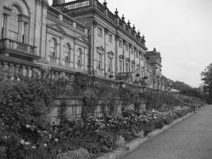
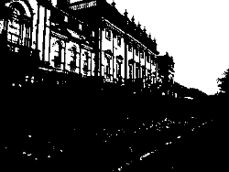
Otsu Thresholding
Nobuyuki Otsu
foreground and background

Slide 13
Image Processing
manipulation of an image
2 purpose:
improving visual appearance
preparing images for measurement

Slide 14


Scaling
resizing (increases or decreases)
efficiency vs smoothness vs sharpness

Slide 15


Cropping
removal of parts

Slide 16
Color Space
Color Model
mathematical or numerical representation
RGB, HSI, CIE L*a*b*

Slide 17
RGB Color Space
Red, Green and Blue color space
most basic and well-known
widely used
fails in dealing with “real world” images

Slide 18


HSI Color Space
more “intuitive”
Hue (H), Saturation (S), Intensity (I)

Slide 19





CIE L*a*b* Color Space
Uniform color model
L* = Lightness, a* and b* = chrominance

Slide 20
Neural Networks
information processing diagram
collection of neuron
extract patterns, detect trends
superior generalization capability
slow learning speed

Slide 21
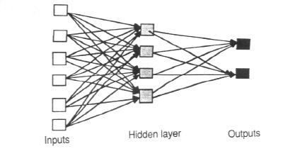
Multilayer Perceptron

Slide 22
Extreme Learning Machines
Huang et al
tries to solve:
intensive human intervention
slow learning speed
“generalized” single-hidden layer feed-forward networks (SLFNs)

Slide 23
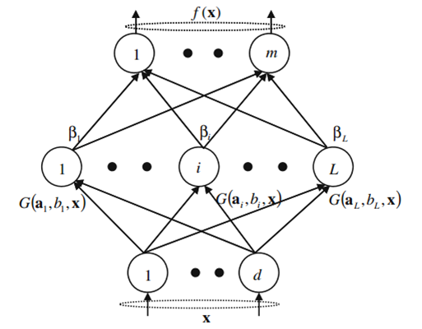
SLFN

Slide 24


Log-Sigmoid Function

Slide 25
Extreme Learning Machines
Given:
- a training set
- hidden node output function
- hidden node number L,
1. Randomly generate hidden node parameters ( ), i = 1 ,…, L.
2. Calculate the hidden layer output matrix H.
3. Calculate the output weight vector β: β = H⁺T

Slide 26



Extreme Learning Machines
N : number of Training Samples
L : number of Hidden nodes
m: number of Output nodes

Slide 27
Moore-Penrose

Slide 28


Regularization Coefficient

Slide 29
Literature Review

Slide 30
Literature Review
Lopez Camelo, A., Gomez P.: Comparison of color indexes for tomato ripening (2004)
Colorimeters, Tomato Ripening
Asadollahi, H., Kamarposhty, M., Teymoori, M.: Classification and Evaluation of Tomato Images Using Several Classifier (2009)
MLP, Random tree classifier, Tomato Classification

Slide 31
Literature Review
Iraji, M., Tosinia, A.: Classification Tomatoes on Machine Vision with Fuzzy the Mamdani Inference, Adaptive Neuro Fuzzy Inference System Based (Anfis-Sugeno) (2011)
FIS, ANFIS, Tomato Classification
Wang, X., Mao, H., Han, X., Yin, J.: Vision-based judgment of tomato maturity under growth conditions (2011)
near-infrared images, RGB/HSI Images, Tomato Classification

Slide 32
Literature Review
Van de Poel, B., Bulens, I., Hertog, M., Van Gastel, L., De Proft, M., Nicolai, B., Geeraerd, A.: Model-based classification of tomato fruit development and ripening related to physiological maturity (2012)
Model-based approach, Tomato Classification
Fojlaley M., Moghadam, P., Nia, S.: Tomato Classification and Sorting with machine vision using SVM, MLP, and LVQ (2012)
LVQ, MLP, SVM, Tomato Classification

Slide 33
Literature Review
Minhas, R., Mohammed, A., Wu, J.: A fast recognition framework based on extreme learning machine using hybrid object information. Neurocomputing (2010)
ELM, Object detection and categorization
Huang, G.B., Ding, X., Zhou, H.: Optimization method based extreme learning machine for classification (2010)
ELM, Classification problems

Slide 34
Literature Review
Huang, G.B., Zhou, H., Ding, X., Zhang, R.: Extreme Learning Machine for Regression and Multiclass Classification (2012)
ELM, Regression and Multiclass problems

Slide 35
Statement of the
Problem

Slide 36
Statement of the Problem
The traditional way of sorting and classification of tomatoes is a very time consuming, tedious, and expensive task. The automation of this task offers a lot of benefits such as reduced identification time, more consistent classification, and improved quality of tomato products which is a necessity in industrial applications.

Slide 37
Objectives

Slide 38
Objectives
To assess the performance of ELM in the evaluation of tomato maturity.
To determine the effect of varying the parameters of ELM such as the number of hidden nodes.

Slide 39
Objectives
To determine the effect of introducing a regularization coefficient to the performance of ELM in the judgment of tomato maturity.
To determine the effect of using the components L*, a*, Hue, red-green difference from the three color models (RGB, HSI, CIE L*a*b*) as inputs to the ELM network.

Slide 40
Proposed Approach

Slide 41
Pipeline of TomatoX
Scaling
Blue Channel
Grayscale Conversion
Masking
Cropping
Feature Extraction
ELM Training
Tomato Classification
Tomato Image

Slide 42
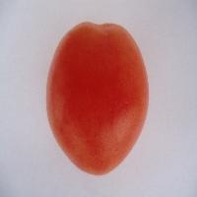
Tomato Image

Slide 43
Scaling
200 x 200

Slide 44
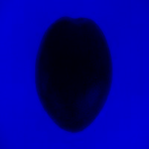

Blue Channel

Slide 45
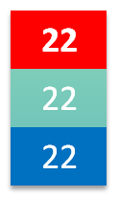

Grayscale Conversion

Slide 46


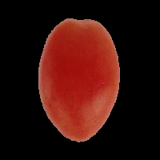
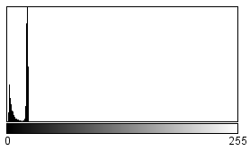

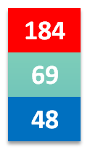
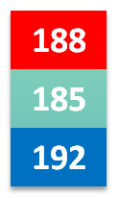
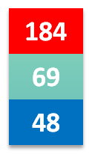
Masking

Slide 47
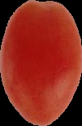
Cropping

Slide 48
Feature Extraction
64 x 64
R-G = 118.97
L* = 40.52
a* = 46.48
H = 6.16

Slide 49
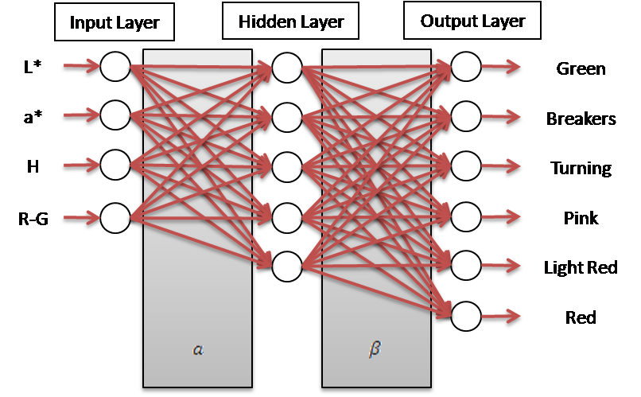
ELM Network Structure

Slide 50




ELM Training
Given:
R-G = 118.97
L* = 40.52
a* = 46.48
H = 6.16

Slide 51
Tomato Classification
Given:

Slide 52
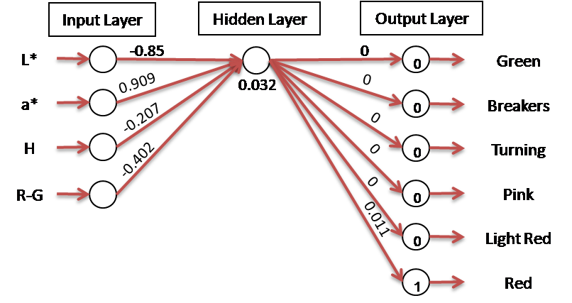
Tomato Classification

Slide 53
Experiments and Results

Slide 54
System Specifications
Hardware
AMD E-350 Processor 1.60 GHz
2.00 GB of RAM
Software
Microsoft Windows 8 Pro 64-bit (6.2, Build 9200)
Eclipse Juno IDE
Java Virtual Machine

Slide 55
Experimental Settings
Dataset = six hundred (600) images
One hundred (100) images per tomato stage
Train set
70% of dataset
Test set
30% of dataset

Slide 56
Standard Configuration
Parameter | Standard Value
Number of Hidden Nodes | 105
Regularization Coefficient (C) | Not set

Slide 57
Experiments
Experiment I
Comparison of fixed and random dataset
Experiment II
Variation in the number of hidden nodes
Experiment III
Variation in the values of the regularization coefficient
Experiment IV
Variation in the number of input color features

Slide 58
Experiment I
 | Fixed |  | Random
 | Test set | Train set | Test set | Train set
Mean | 97.593% | 98.865% | 97.185% | 98.905%

Slide 59
Experiment II
N, 0.75N, 0.5N, 0.25N
N = number of samples
Set | Number of Hidden Nodes
A | 105
B | 210
C | 315
D | 420

Slide 60
Experiment II
 | A | B | C | D
Mean | 97.593% | 96.796% | 94.667% | 87.463%

Slide 61
Experiment II
 | A | B | C | D
Mean | 98.865% | 99.556% | 99.714% | 99.952%

Slide 62
%
Experiment III
 | No C | 1 | 10 | 20 | 30 | 40 | 50
Mean | 97.593% | 98.259% | 98.13% | 98.074% | 98.056% | 98.148% | 98.28%

Slide 63
Experiment IV
Set | Color Feature (s)
A | R-G
B | H, R-G
C | L*, a*
D | L*, a*, H, R-G
E | R, G, R-G, H, a

Slide 64
Experiment IV
 | A | B | C | D | E
Mean | 96.037% | 94.444% | 96.741% | 97.593% | 95.833%

Slide 65
Benchmark
 | Current Research | TotoBee
Accuracy | 97.593% | 98.19 %
Training Time (sec) | 1.89 | 153.46

Slide 66
Conclusion and
Future Works

Slide 67
Conclusions
ELM classifier is robust
The number of hidden nodes can affect the performance of ELM
The introduction of a regularization coefficient (C) further improves the performance of ELM

Slide 68
Conclusions
The proposed input features (L*, a*, Hue, r-g) performed well
ELM is an efficient method in the classification of tomatoes

Slide 69
Future Work
Extension to real-time tomato classification
Online-Sequential ELM (OS-ELM)
Other vegetables or fruits such as bananas

Slide 70
DEMO

